Slide 1


Kabir Atobatele
1st July, 2024

Slide 2

Outline
Executive Summary
Introduction
Methodology
Results
Conclusion
Appendix

Slide 3
Executive Summary
Summary of methodologies
Data Inspection
Data Cleaning
Exploratory Data Analysis (EDA)
Feature Engineering
Data Preprocessing
Machine Learning
Comparative Analysis
Summary of all results
Exploratory Data Analysis result
Interactive analytics in screenshots
Predictive Analytics result

Slide 4
Introduction
Project background and context
Air pollution is the world’s largest environmental healthrisk, contributing to 7million premature deaths globally each year, and poor people in developing countries are the most heavily aected. Low-cost IoT sensor networks on the ground have the potential to close the climate data gaps in sub-Saharan Africa, but networks are expensive to implement and maintain in African cities.
Satellite-derived PM2.5 estimates based on Aerosol Optical Depth (AOD) and machine learning techniques can be used to estimate pollution levels over large areas to help develop interventions such as vulnerability risk proles for urban spaces, health preservation and environmental protection for affected populations, as well as community empowerment, and climate change mitigation.
Problems you want to find answers
Estimate PM2.5 levels from satellite observations based on Aerosol Optical Depth (AOD) for eight cities in seven African countries Lagos, Accra, Nairobi, Yaounde, Bujumbura, Kisumu, Kampala, and Gulu - with varying ground monitoring resolutions, using appropriate machine learning algorithms.
Spatial and Temporal Trends
Long-Term Monitoring
Notes:
Spatial and Temporal trends
Satellites provide data for vast geographical areas, allowing for the observation of regional and global PM2.5 patterns.
They can track the movement of pollution plumes over time, helping to identify pollution sources and transport pathways.
Long-term monitoring
Satellite observations offer a historical record of air quality changes, enabling the assessment of trends over time.
This data can be used to evaluate the effectiveness of air quality regulations and track progress towards clean air goals.

Slide 5


Slide 6
Methodology
Executive Summary
Data collection methodology:
Primary Data was provided for the project.
Perform data wrangling
Standard Scaler was applied to categorical features for data preprocessing.
Perform exploratory data analysis (EDA) using visualization
Perform predictive analysis using classification model such as PCA and Ridge regression.
Notes:
How to build, tune, evaluate classification models

Slide 7

Data Collection – SpaceX API
We used the get request to the SpaceX API to collect data, clean the requested data and did some basic data wrangling and formatting.
The link to the notebook is https://github.com/chuksoo/IBM-Data-Science-Capstone-SpaceX/blob/main/Data%20Collection%20API.ipynb.

Slide 8
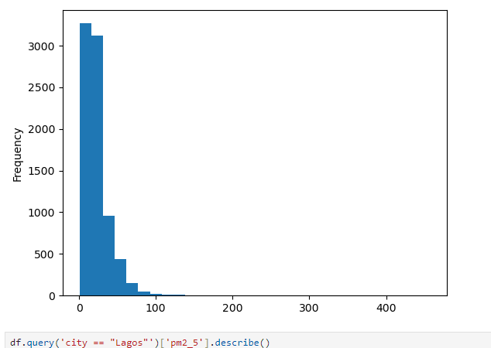
Data Wrangling
We performed exploratory data analysis and determined the training labels.
We calculated the number of launches at each site, and the number and occurrence of each orbits
We created landing outcome label from outcome column and exported the results to csv.
The link to the notebook is https://github.com/chuksoo/IBM-Data-Science-Capstone-SpaceX/blob/main/Data%20Wrangling.ipynb.

Slide 9

EDA with Data Visualization
We explored the data by visualizing the relationship between flight number and launch Site, payload and launch site, success rate of each orbit type, flight number and orbit type, the launch success yearly trend.
The link to the notebook is https://github.com/chuksoo/IBM-Data-Science-Capstone-SpaceX/blob/main/EDA%20with%20Data%20Visualization.ipynb

Slide 10
EDA with SQL
We loaded the SpaceX dataset into a PostgreSQL database without leaving the jupyter notebook.
We applied EDA with SQL to get insight from the data. We wrote queries to find out for instance:
The names of unique launch sites in the space mission.
The total payload mass carried by boosters launched by NASA (CRS)
The average payload mass carried by booster version F9 v1.1
The total number of successful and failure mission outcomes
The failed landing outcomes in drone ship, their booster version and launch site names.
The link to the notebook is https://github.com/chuksoo/IBM-Data-Science-Capstone-SpaceX/blob/main/EDA%20with%20SQL.ipynb

Slide 11
Build an Interactive Map with Folium
We marked all launch sites, and added map objects such as markers, circles, lines to mark the success or failure of launches for each site on the folium map.
We assigned the feature launch outcomes (failure or success) to class 0 and 1.i.e., 0 for failure, and 1 for success.
Using the color-labeled marker clusters, we identified which launch sites have relatively high success rate.
We calculated the distances between a launch site to its proximities. We answered some question for instance:
Are launch sites near railways, highways and coastlines.
Do launch sites keep certain distance away from cities.

Slide 12
Build a Dashboard with Plotly Dash
We built an interactive dashboard with Plotly dash
We plotted pie charts showing the total launches by a certain sites
We plotted scatter graph showing the relationship with Outcome and Payload Mass (Kg) for the different booster version.
The link to the notebook is https://github.com/chuksoo/IBM-Data-Science-Capstone-SpaceX/blob/main/app.py

Slide 13
Predictive Analysis (Classification)
We loaded the data using numpy and pandas, transformed the data, split our data into training and testing.
We built different machine learning models and tune different hyperparameters using GridSearchCV.
We used accuracy as the metric for our model, improved the model using feature engineering and algorithm tuning.
We found the best performing classification model.

Slide 14
Results
Exploratory data analysis results
Interactive analytics demo in screenshots
Predictive analysis results

Slide 15


Slide 16

Flight Number vs. Launch Site
From the plot, we found that the larger the flight amount at a launch site, the greater the success rate at a launch site.

Slide 17


Payload vs. Launch Site

Slide 18

Success Rate vs. Orbit Type
From the plot, we can see that ES-L1, GEO, HEO, SSO, VLEO had the most success rate.

Slide 19

Flight Number vs. Orbit Type
The plot below shows the Flight Number vs. Orbit type. We observe that in the LEO orbit, success is related to the number of flights whereas in the GTO orbit, there is no relationship between flight number and the orbit.

Slide 20

Payload vs. Orbit Type
We can observe that with heavy payloads, the successful landing are more for PO, LEO and ISS orbits.

Slide 21
Launch Success Yearly Trend
From the plot, we can observe that success rate since 2013 kept on increasing till 2020.

Slide 22

All Launch Site Names
We used the key word DISTINCT to show only unique launch sites from the SpaceX data.

Slide 23

Launch Site Names Begin with 'CCA'
We used the query above to display 5 records where launch sites begin with `CCA`

Slide 24

Scatter plot of Payload vs Launch Outcome for all sites, with different payload selected in the range slider

Slide 25


Slide 26

Classification Accuracy
The decision tree classifier is the model with the highest classification accuracy

Slide 27

Confusion Matrix
The confusion matrix for the decision tree classifier shows that the classifier can distinguish between the different classes. The major problem is the false positives .i.e., unsuccessful landing marked as successful landing by the classifier.

Slide 28
Conclusions
We can conclude that:
The larger the flight amount at a launch site, the greater the success rate at a launch site.
Launch success rate started to increase in 2013 till 2020.
Orbits ES-L1, GEO, HEO, SSO, VLEO had the most success rate.
KSC LC-39A had the most successful launches of any sites.
The Decision tree classifier is the best machine learning algorithm for this task.

Slide 29


